Slide 1

Portfolio Optimization and the Case of the Diverging Markowitz Frontier
Is the S&P 500 a valid investment pool on its own?

Slide 2
The Question
“How does portfolio volatility change at differing levels of return when its characteristics are determined by economic sector weight restrictions dictated by the S&P 500 index?”

Slide 3
The Motivation
Today more than half of U.S. households have some form of direct or indirect investments in the stock market.
This study aimed to determine how investing solely in stocks in the S&P 500 can improve portfolio returns while minimizing risk.
According to the Pew Research Center 14% of American families are directly involved in individual stocks while a majority, roughly 52%, have some level on involvement in the market.

Slide 4
Methodology
The question at hand was answered through comparing the volatility of portfolios that had been subjected to asset representation constraints with the volatility of portfolios that had no asset representation constraints.
The mathematical models utilized came from the work put forth by Harry Markowitz which focused on utilizing mean-variance analysis.
The simulation described was split into three parts based on agent investment methodologies: Random, Random Representation and Equal Representation.
Notes:
-The question was evaluated by through a Ceteris Paribus simulation utilizing theoretical mathematical models and real-world S&P 500 data.
The simulation was constructed and ran in python, all data generated was also be analyzed in python.
MVA: a mathematical model which develops a collection of portfolios that maximize their returns for a given amount of risk.

Slide 5
Investment strategies
Portfolios constructed using the assets selected by the Random investment agent served as the control group, no restrictions were implemented when selecting assets from entire S&P 500.
For the Random Representation investment agent, an array of length 11 that summed to n, where n is the number of assets the agent can select, was randomly generated.
For Equal Representation investment agent, an array of length 11, whose index values are all equal and sum to n will be randomly generated.

Slide 6

Model Outline - Returns
Each companies daily adjusted closing prices were converted into normalized daily return prices through the following formula:
Log returns are symmetric compared to percentage change returns; in theory they lead to better results for most models.
These prices were then summed an averaged to determine each companies mean returns.

Slide 7
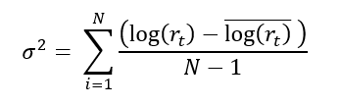
Model Outline - Volatility
Using each stock’s mean log returns, their variance was calculated for each company:

Slide 8

Model Outline – The Covariance Matrix
Additionally, expected volatility () can also be expressed as a product of the portfolio’s covariance matrix:
Where represents the portfolios covariance matrix (note the terms beneath the radicand).

Slide 9
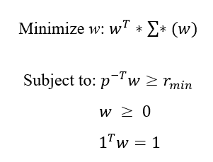
Model Outline – Markowitz Frontier
Markowitz's main insight was that you can minimize the risk you take for any level of return by diversifying a portfolio.
Result is a positive definite quadratic form that demonstrates greater returns are associated with higher risk.
Where w, a weight vector, is always positive and sums to one, the vector of most importance is w.
Notes:
- often called the Markowitz Bullet,

Slide 10
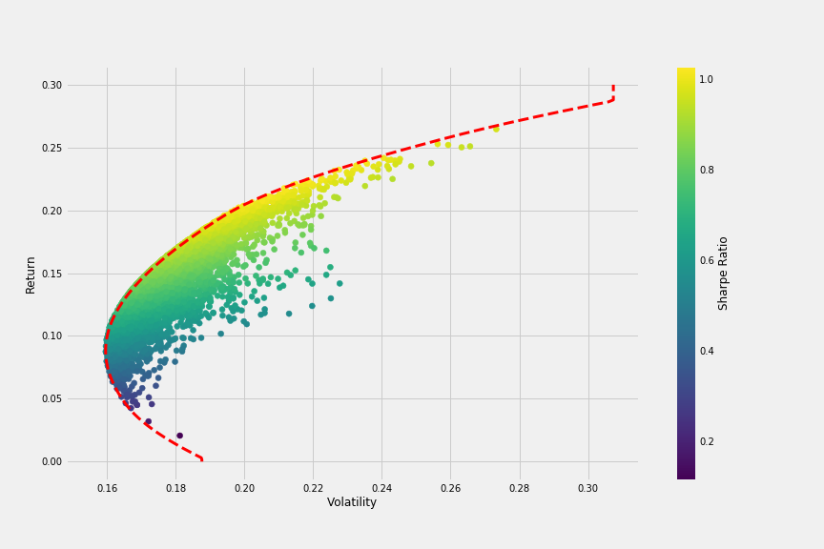
Markowitz Frontier Example
The result of the minimization problem is often called a Markowitz Bullet.
Plots an uncountably infinite combination of w’s, each individual dot is a portfolio.
Colored by their Sharpe Ratio, which describes how much excess return is received for each extra unit of volatility endured for holding a riskier asset.
Notes:
- Every portfolio has the same companies

Slide 11
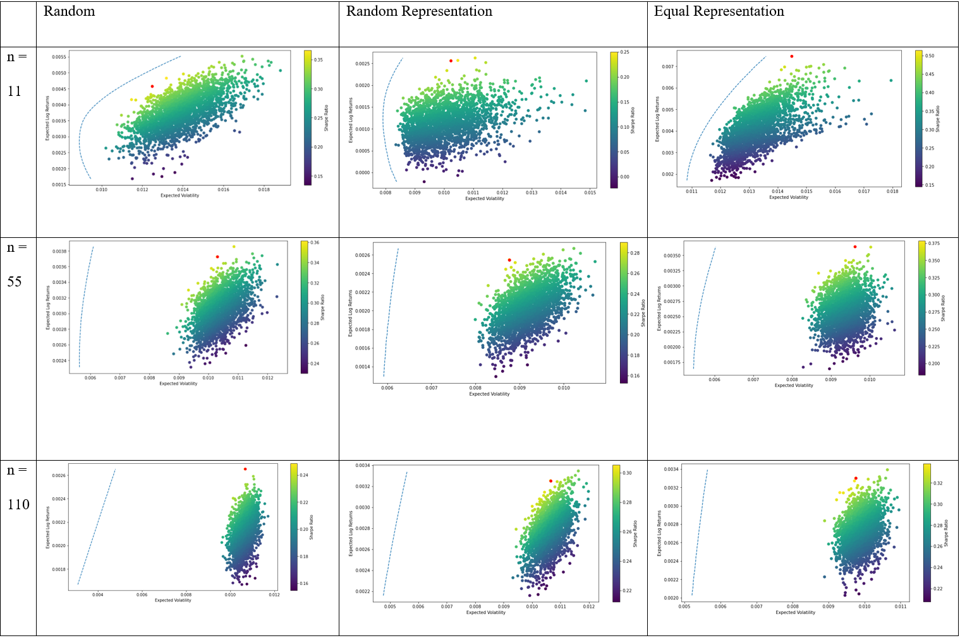

Slide 12
The unanswerable why
It was at this point in my research that I hit a roadblock; I did not know the answer as to why the Frontier was diverging.
Contacted Doctor Ahmad Bazzi, a convex optimization specialist from France who wrote the Python code that I adapted for my project.
I sent him my code and he got back to me with an answer, we later met through zoom and he proceeded to explain the reason as to why the Frontier diverged.
Most of what he explained to me I did not understand, but I have tried my best in order to convey what I did understand.
I am interested in learning more about this problem.

Slide 13
The Case Of The Diverging Fronter
It should be considered that the problem of the diverging Efficient Frontier is relatively intuitive.
Each investor within this research had many assets in their portfolios drawn from the S&P 500, which consists of the 500 largest companies that are traded on the NYSE and NASDAQ.
It is quite possible that due to the nature of the S&P 500, the problem of multicollinearity occurred because of the high correlation of assets within a specific industry branch.
Since many companies in the S&P 500 belong to the same sector, it would not make sense to invest in stocks that move the same way.

Slide 14
The Linear Approach
Mathematically this is reflected within the covariance matrix in which all portfolios derive from within this research.
In every case, the covariance matrix was:
Not full-rank.
Not well – conditioned.
Possessed eigenvalues close to Zero.
As a result, each covariance matrix generated was ill-conditioned and singular, mapping all w's to the null space.

Slide 15

The Linear Apprach Continued
Singular covariance matrices result in circular portfolio frontiers, of which make it difficult to both fit the Efficient Frontier and find an efficient portfolio.
The Markowitz Frontier seeks to solve the following minimization problem and find the Efficient Frontier that minimizes the following cost function:
The w's mapped to the null space all become “optimal,” and nullify the cost function when selected, yet which w is the one selected?
The simulation was unable to solve the minimization problem, resulting in the diverging frontier.

Slide 16
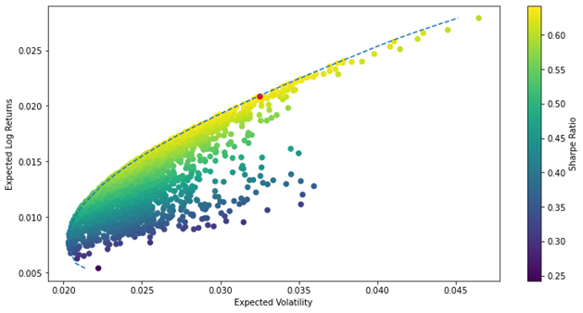
A Good Example
Consider this collection of companies, CEVA, GOOGL, TSLA and AAPL.
Rank was 4.
Condition value was 27.28.
The ratio of its largest eigenvalue to smallest eigenvalue was also 27.28, making the matrix normal.
Commutes with its conjugate transpose.
Notes:
- A complex square matrix A is normal if it commutes with its conjugate transpose A*

Slide 17
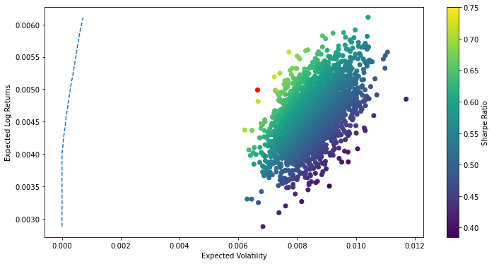
A Bad Example
Compare the previous results to the following collection of 55 random companies.
Rank was 11.
Condition value was extremely large.
The ratio of its largest eigenvalue to smallest eigenvalue was completely different, making the matrix not normal.
Notes:
- Singular values were not the abs(eigenvalues)

Slide 18
Potential Solutions
A potential solution to this problem is to take a finite value, which shall be called alpha, and multiply the identity matrix of size n by it.
After doing so this new matrix can be added to the covariance matrix (∑) in order to increase its eigenvalues, this process is known as regularization.
By reconditioning the covariance matrix, the hope is to help it become full-rank and well-conditioned through changing is eigenvalues through alpha
We could also perfom row reduction on the transpose of the covariance matrix
We could also select companies one by one and see how the covariance matrix changes

Slide 19
Discussion
Overall, this study found that portfolios consisting of only stocks from the S&P 500, taking a long position, are suboptimal.
Portfolios consisting of stock and only stocks are unrealistic.
Initial question led to problems that have spawned new questions:​
“How do the rank and condition of a portfolio’s covariance matrix impact its volatility and return?” ​
“How can an ill-conditioned covariance matrices be reconditioned and used to improve a portfolios volatility and returns?” ​
"How can you construct a well-conditioned, full-rank covariance matrix efficiently?"​

Slide 20
Take Away
What I hope for everyone to understand is that quantifying risk through a covariance matrix in Portfolio Optimization is extremely complex and important.
Sometimes the results can be unexpected and abnormal, but that’s okay, it’s apart of the research process.

Slide 21
Questions?
Slides available at:

Slide 22
Special Thank you to Doctor Ahmad Bazzi https://www.youtube.com/c/AhmadBazzi/about

